Slide 1
Active Contours Without Edges
Group A2
John Charlesworth
Michael Hodgson

Slide 2
Contents
Introduction
Theory
Implementation
Results
Demo
Extensions

Slide 3
Introduction
Method for detection of objects within an image
Minimise an energy function
Does not use any edge detection

Slide 4
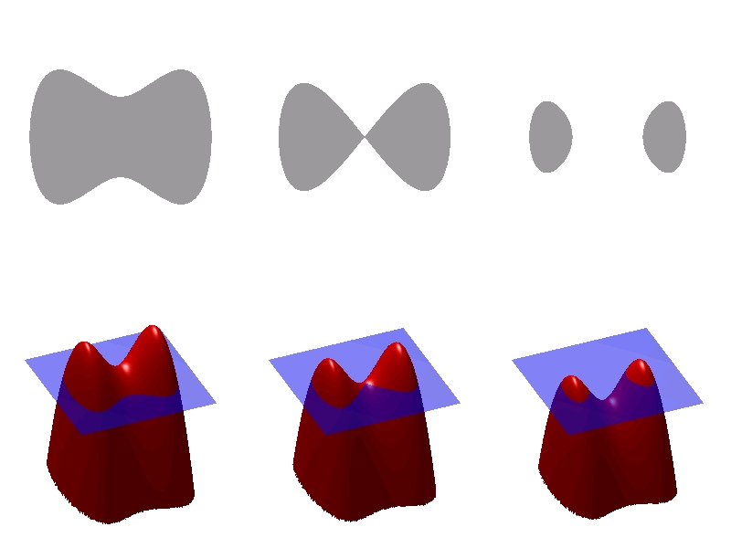
Theory – Level Sets
Parameterising shapes is difficult
Particularly difficult if they change with time
Level sets allow you to model a shape without parameterising it
Zero level is the contour being evolved
http://en.wikipedia.org/wiki/File:Level_set_method.jpg
ɸ - the level set function

Slide 5
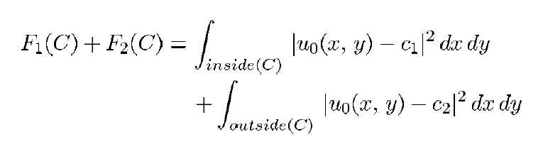
Theory – Minimising the Energy
The curve evolves based on its internal and external forces
When these forces are minimised you are at the shape boundary

Slide 6
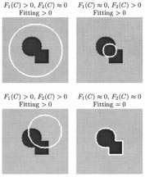
Theory – Minimising the Energy
c1 is the average inside the curve
c2 is the average outside the curve
Forces are attractive

Slide 7
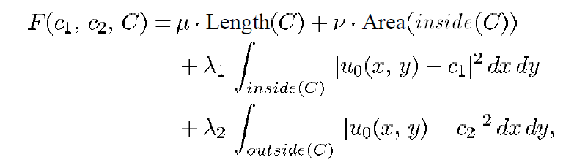
Theory – Constraining the Behaviour

